Slide 1

Graphs
C H A P T E R 18
So I draw the world together link by link: Yea, from Delos up to Limerick and back!
—Rudyard Kipling, “The Song of the Banjo,” 1894
18.1 The structure of a graph
18.2 Representation strategies
18.3 A low-level graph abstraction
18.4 Graph traversals
18.5 Defining a Graph class
18.6 Finding shortest paths
18.7 Algorithms for searching the web

Slide 2
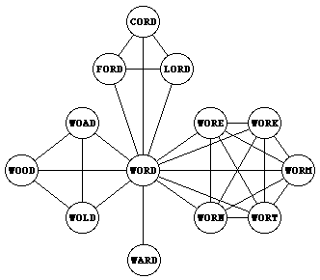
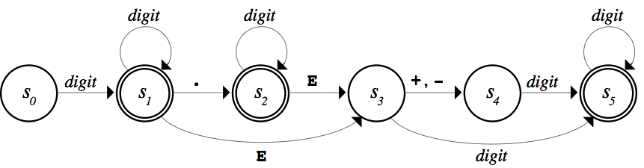


Examples of Graphs

Slide 3
The Definition of a Graph
A graph consists of a set of nodes together with a set of arcs. The nodes correspond to the dots or circles in a graph diagram (which might be cities, words, neurons, or who knows what) and the arcs correspond to the links that connect two nodes.
In some graphs, arcs are shown with an arrow that indicates the direction in which two nodes are linked. Such graphs are called directed graphs.
Other graphs, arcs are simple connections indicating that one can move in either direction between the two nodes. These graphs are undirected graphs.
Question: Which of these two structures is more general?

Slide 4
Graph Terminology
Mathematicians often use the words vertex and edge for the structures that computer scientists call node and arc. We’ll stick with the computer science names, but you might see their mathematical counterparts in algorithmic descriptions.
The nodes to which a particular node is connected are called its neighbors.
In an undirected graph, the number of connections from a node is called its degree. In a directed graph, the number of arcs leading outward is called the out-degree, and the number of arcs leading inward is called the in-degree.
A series of arcs that connect two nodes is called a path. A path that returns to its starting point is called a cycle.
A graph in which there is a path between every pair of nodes is said to be connected.

Slide 5
Designing a Graph Interface
To take maximum advantage of the intuition that people have with graphs, it makes sense to design a graph package in C++ so that it adheres as closely as possible to the way graphs in mathematics. In particular, the idea that a graph is a set of nodes together with a set of arcs should be clear from the definition.
Both nodes and arcs have some properties that are closely tied to the graph in which they belong. Each node, for example, must keep track of the arcs that lead to its neighbors. In much the same way, each arc needs to know what nodes it connects.
At the same time, both nodes and arcs are likely to contain other information that depends on the application, such as the name of a node or the cost of traversing an arc.

Slide 6
Three Strategies
1.
Use low-level structures. This design uses the structure types Node and Arc to represent the components of a graph. This model gives clients complete freedom to extend these structures but offers no support for graph operations.
2.
Define classes for each of the component types. This design uses the Node and Arc classes to define the structure. In this model, clients define subclasses of the supplied types to particularize the graph data structure to their own application.
3.
Adopt a hybrid strategy. This design defines a Graph class but parameterizes that class so that it can use any structures or objects as the node and arc types. This strategy retains the flexibility of the low-level model and avoids the complexity associated with the class-based approach.

Slide 7
The low-level graphtypes.h Interface
/*
* File: graphtypes.h
* ------------------
* This file defines low-level data structures that represent graphs.
*/
#ifndef _graphtypes_h
#define _graphtypes_h
#include <string>
#include "map.h"
#include "set.h"
struct Node; /* Forward references to these two types so */
struct Arc; /* that the C++ compiler can recognize them. */
/*
* Type: SimpleGraph
* -----------------
* This type represents a graph and consists of a set of nodes, a set of
* arcs, and a map that creates an association between names and nodes.
*/
struct SimpleGraph {
Set<Node *> nodes;
Set<Arc *> arcs;
Map<std::string,Node *> nodeMap;
};

Slide 8
The low-level graphtypes.h Interface
/*
* Type: Node
* ----------
* This type represents an individual node and consists of the
* name of the node and the set of arcs from this node.
*/
struct Node {
std::string name;
Set<Arc *> arcs;
};
/*
* Type: Arc
* ---------
* This type represents an individual arc and consists of pointers
* to the endpoints, along with the cost of traversing the arc.
*/
struct Arc {
Node *start;
Node *finish;
double cost;
};
#endif
/*
* File: graphtypes.h
* ------------------
* This file defines low-level data structures that represent graphs.
*/
#ifndef _graphtypes_h
#define _graphtypes_h
#include <string>
#include "map.h"
#include "set.h"
struct Node; /* Forward references to these two types so */
struct Arc; /* that the C++ compiler can recognize them. */
/*
* Type: SimpleGraph
* -----------------
* This type represents a graph and consists of a set of nodes, a set of
* arcs, and a map that creates an association between names and nodes.
*/
struct SimpleGraph {
Set<Node *> nodes;
Set<Arc *> arcs;
Map<std::string,Node *> nodeMap;
};

Slide 9
Depth-First Search
The traversal strategy of depth-first search (or DFS for short) recursively processes the graph, following each branch, visiting nodes as it goes, until every node is visited.
The depth-first search algorithm requires some structure to keep track of nodes that have already been visited. Common strategies are to include a visited flag in each node or to pass a set of visited nodes, as shown in the following code:
void depthFirstSearch(Node *start) {
Set<Node *> visited;
visitUsingDFS(start, visited);
}
void visitUsingDFS(Node *start, Set<Node *> & visited) {
if (visited.contains(start)) return;
visit(start);
visited.add(start);
foreach (Arc *ap in start->arcs) {
visitUsingDFS(ap->finish, visited);
}
}

Slide 10
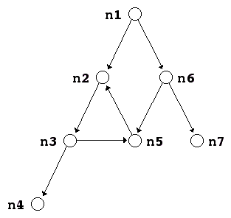
Breadth-First Search
The traversal strategy of breadth-first search (which you used on Assignment #2) proceeds outward from the starting node, visiting the start node, then all nodes one hop away, and so on.
For example, consider the graph:
Breadth-first search begins at the start node (n1), then does the one-hops (n2 and n6), then the two hops (n3, n5, and n7) and finally the three hops (n4).

Slide 11
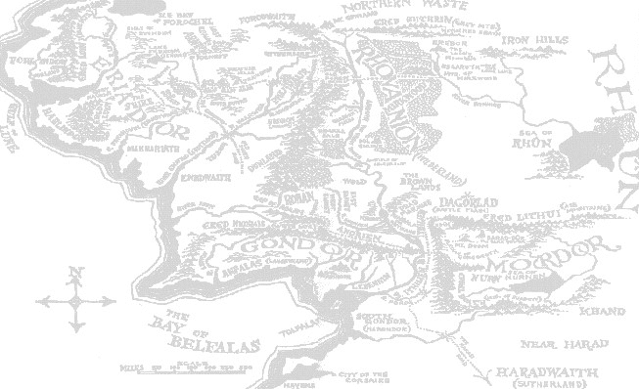
The Middle Earth Graph
Hobbiton
10
Bree
30
Rivendell
1
Southfarthing
10
30
Caradhras
Moria
30
50
40
Lorien
Isengard
10
5
50
10
Rauros
BlackGate
Edoras
20
15
70
15
20
MountDoom
MinasTirith
30
40
CirithUngol

Slide 12
Exercise: Depth-First Search
Construct a depth-first search starting from Hobbiton (HOB):
BRE
Visiting node HOB
Visiting node BRE
Visiting node RIV
Visiting node CAR
Visiting node LOR
Visiting node EDO
Visiting node ISE
Visiting node SOU
Visiting node MIN
Visiting node CIR
Visiting node BLA
Visiting node MOU
Visiting node RAU
Visiting node MOR
HOB
RIV
SOU
CAR
MOR
LOR
ISE
EDO
RAU
BLA
MOU
MIN
CIR

Slide 13
Exercise: Breadth-First Search
Construct a breadth-first search starting from Isengard (ISE):
BRE
Visiting node ISE
Visiting node EDO
Visiting node SOU
Visiting node LOR
Visiting node MIN
Visiting node RAU
Visiting node HOB
Visiting node CAR
Visiting node MOR
Visiting node CIR
Visiting node BLA
Visiting node BRE
Visiting node RIV
Visiting node MOU
HOB
RIV
SOU
CAR
MOR
LOR
ISE
EDO
RAU
BLA
MOU
MIN
CIR
Queue:
ISE
EDO
SOU
LOR
MIN
RAU
HOB
CAR
MOR
CIR
BLA
BRE
RIV
MOU

Slide 14
The class-based graph.h Interface
/*
* File: graph.h
* -------------
* This interface exports a parameterized Graph class used to represent
* graphs, which consist of a set of nodes and a set of arcs.
*/
#ifndef _graph_h
#define _graph_h
#include <string>
#include "error.h"
#include "map.h"
#include "set.h"
/*
* Functions: nodeCompare, arcCompare
* ----------------------------------
* Standard comparison functions for nodes and arcs.
*/
template <typename NodeType>
int nodeCompare(NodeType *n1, NodeType *n2);
template <typename NodeType,typename ArcType>
int arcCompare(ArcType *a1, ArcType *a2);

Slide 15
The class-based graph.h Interface
/*
* Class: Graph<NodeType,ArcType>
* ------------------------------
* This class represents a graph with the specified node and arc types.
* The NodeType and ArcType parameters indicate the structure type or class
* used for nodes and arcs, respectively. These types can contain any
* fields or methods required by the client, but must contain the following
* public fields required by the Graph package itself:
*
* The NodeType definition must include:
* - A string field called name
* - A Set<ArcType *> field called arcs
*
* The ArcType definition must include:
* - A NodeType * field called start
* - A NodeType * field called finish
*/
template <typename NodeType,typename ArcType>
class Graph {
public:
/*
* File: graph.h
* -------------
* This interface exports a parameterized Graph class used to represent
* graphs, which consist of a set of nodes and a set of arcs.
*/
#ifndef _graph_h
#define _graph_h
#include <string>
#include "error.h"
#include "map.h"
#include "set.h"
/*
* Functions: nodeCompare, arcCompare
* ----------------------------------
* Standard comparison functions for nodes and arcs.
*/
template <typename NodeType>
int nodeCompare(NodeType *n1, NodeType *n2);
template <typename NodeType,typename ArcType>
int arcCompare(ArcType *a1, ArcType *a2);

Slide 16
The class-based graph.h Interface
/*
* Constructor: Graph
* Usage: Graph<NodeType,ArcType> g;
* ---------------------------------
* Creates an empty Graph object.
*/
Graph();
/*
* Destructor: ~Graph
* Usage: (usually implicit)
* -------------------------
* Frees the internal storage allocated to represent the graph.
*/
~Graph();
/*
* Class: Graph<NodeType,ArcType>
* ------------------------------
* This class represents a graph with the specified node and arc types.
* The NodeType and ArcType parameters indicate the structure type or class
* used for nodes and arcs, respectively. These types can contain any
* fields or methods required by the client, but must contain the following
* public fields required by the Graph package itself:
*
* The NodeType definition must include:
* - A string field called name
* - A Set<ArcType *> field called arcs
*
* The ArcType definition must include:
* - A NodeType * field called start
* - A NodeType * field called finish
*/
template <typename NodeType,typename ArcType>
class Graph {
public:

Slide 17
The class-based graph.h Interface
/*
* Method: size
* Usage: int size = g.size();
* ---------------------------
* Returns the number of nodes in the graph.
*/
int size();
/*
* Method: isEmpty
* Usage: if (g.isEmpty()) . . .
* -----------------------------
* Returns true if the graph is empty.
*/
bool isEmpty();
/*
* Method: clear
* Usage: g.clear();
* -----------------
* Reinitializes the graph to be empty, freeing any heap storage.
*/
void clear();
/*
* Constructor: Graph
* Usage: Graph<NodeType,ArcType> g;
* ---------------------------------
* Creates an empty Graph object.
*/
Graph();
/*
* Destructor: ~Graph
* Usage: (usually implicit)
* -------------------------
* Frees the internal storage allocated to represent the graph.
*/
~Graph();

Slide 18
The class-based graph.h Interface
/*
* Method: addNode
* Usage: NodeType *node = g.addNode(name);
* NodeType *node = g.addNode(node);
* ----------------------------------------
* Adds a node to the graph. The first version of this method creates a
* new node of the appropriate type and initializes its fields; the second
* assumes that the client has already created the node and simply adds it
* to the graph. Both versions of this method return a pointer to the node.
*/
NodeType *addNode(std::string name);
NodeType *addNode(NodeType *node);
/*
* Method: getNode
* Usage: NodeType *node = g.getNode(name);
* ----------------------------------------
* Looks up a node in the name table attached to the graph and returns a
* pointer to that node. If no node with the specified name exists,
* getNode signals an error.
*/
NodeType *getNode(std::string name);
/*
* Method: size
* Usage: int size = g.size();
* ---------------------------
* Returns the number of nodes in the graph.
*/
int size();
/*
* Method: isEmpty
* Usage: if (g.isEmpty()) . . .
* -----------------------------
* Returns true if the graph is empty.
*/
bool isEmpty();
/*
* Method: clear
* Usage: g.clear();
* -----------------
* Reinitializes the graph to be empty, freeing any heap storage.
*/
void clear();

Slide 19
The class-based graph.h Interface
/*
* Method: addArc
* Usage: g.addArc(s1, s2);
* g.addArc(n1, n2);
* g.addArc(arc);
* ---------------------
* Adds an arc to the graph. The endpoints of the arc can be specified
* either as strings indicating the names of the nodes or as pointers to
* the node structures. Alternatively, the client can create the arc
* structure explicitly and pass that pointer to the addArc method. All
* three of these versions return a pointer to the arc in case the client
* needs to capture this value.
*/
ArcType *addArc(std::string s1, std::string s2);
ArcType *addArc(NodeType *n1, NodeType *n2);
ArcType *addArc(ArcType *arc);
/*
* Method: addNode
* Usage: NodeType *node = g.addNode(name);
* NodeType *node = g.addNode(node);
* ----------------------------------------
* Adds a node to the graph. The first version of this method creates a
* new node of the appropriate type and initializes its fields; the second
* assumes that the client has already created the node and simply adds it
* to the graph. Both versions of this method return a pointer to the node.
*/
NodeType *addNode(std::string name);
NodeType *addNode(NodeType *node);
/*
* Method: getNode
* Usage: NodeType *node = g.getNode(name);
* ----------------------------------------
* Looks up a node in the name table attached to the graph and returns a
* pointer to that node. If no node with the specified name exists,
* getNode signals an error.
*/
NodeType *getNode(std::string name);

Slide 20
The class-based graph.h Interface
/*
* Method: isConnected
* Usage: if (g.isConnected(n1, n2)) . . .
* if (g.isConnected(s1, s2)) . . .
* ---------------------------------------
* Returns true if the graph contains an arc from n1 to n2. As in the
* addArc method, nodes can be specified either as node pointers or by
* name.
*/
bool isConnected(NodeType *n1, NodeType *n2);
bool isConnected(std::string s1, std::string s2);
/*
* Method: getNeighbors
* Usage: foreach (NodeType *node in g.getNeighbors(node)) . . .
* foreach (NodeType *node in g.getNeighbors(name)) . . .
* -------------------------------------------------------------
* Returns the set of nodes that are neighbors of the specified node, which
* can be indicated either as a pointer or by name.
*/
Set<NodeType *> getNeighbors(NodeType *node);
Set<NodeType *> getNeighbors(std::string node);
/*
* Method: addArc
* Usage: g.addArc(s1, s2);
* g.addArc(n1, n2);
* g.addArc(arc);
* ---------------------
* Adds an arc to the graph. The endpoints of the arc can be specified
* either as strings indicating the names of the nodes or as pointers to
* the node structures. Alternatively, the client can create the arc
* structure explicitly and pass that pointer to the addArc method. All
* three of these versions return a pointer to the arc in case the client
* needs to capture this value.
*/
ArcType *addArc(std::string s1, std::string s2);
ArcType *addArc(NodeType *n1, NodeType *n2);
ArcType *addArc(ArcType *arc);

Slide 21
The class-based graph.h Interface
/*
* Method: getNodeSet
* Usage: foreach (NodeType *node in g.getNodeSet()) . . .
* -------------------------------------------------------
* Returns the set of all nodes in the graph.
*/
Set<NodeType *> & getNodeSet();
/*
* Method: getArcSet
* Usage: foreach (ArcType *arc in g.getArcSet()) . . .
* foreach (ArcType *arc in g.getArcSet(node)) . . .
* foreach (ArcType *arc in g.getArcSet(name)) . . .
* --------------------------------------------------------
* Returns the set of all arcs in the graph or, in the second and third
* forms, the arcs that start at the specified node, which can be indicated
* either as a pointer or by name.
*/
Set<ArcType *> & getArcSet();
Set<ArcType *> & getArcSet(NodeType *node);
Set<ArcType *> & getArcSet(std::string name);
/*
* Method: isConnected
* Usage: if (g.isConnected(n1, n2)) . . .
* if (g.isConnected(s1, s2)) . . .
* ---------------------------------------
* Returns true if the graph contains an arc from n1 to n2. As in the
* addArc method, nodes can be specified either as node pointers or by
* name.
*/
bool isConnected(NodeType *n1, NodeType *n2);
bool isConnected(std::string s1, std::string s2);
/*
* Method: getNeighbors
* Usage: foreach (NodeType *node in g.getNeighbors(node)) . . .
* foreach (NodeType *node in g.getNeighbors(name)) . . .
* -------------------------------------------------------------
* Returns the set of nodes that are neighbors of the specified node, which
* can be indicated either as a pointer or by name.
*/
Set<NodeType *> getNeighbors(NodeType *node);
Set<NodeType *> getNeighbors(std::string node);
The private and implementation sections go here.

Slide 22
The Private Section of graph.h
/* Private section */
private:
/*
* Implementation notes: Data structure
* ------------------------------------
* The Graph class is defined -- as it traditionally is in
* mathematics -- as a set of nodes and a set of arcs. These
* structures, in turn, are implemented using the Set class.
* The element type for each set is a pointer to a structure
* chosen by the client, which is specified as one of the
* parameters to the class template.
*/
/* Instance variables */
Set<NodeType *> nodes;
Set<ArcType *> arcs;
Map<std::string, NodeType *> nodeMap;
/* The set of nodes in the graph */
/* The set of arcs in the graph */
/* A map from names to nodes */

Slide 23
The Implementation Section
/* Implementation notes: Graph class
* ---------------------------------
* As is typical for layered abstractions built on top of other classes,
* the implementations of the methods in the graph class tend to be very
* short, because they can hand all the hard work off to the underlying
* class.
*/
Exercise: Implement the two versions of addNode
/*
* Method: addNode
* Usage: g.addNode(name);
* g.addNode(node);
* -----------------------
* Adds a node to the graph. The first version of this method
* creates a new node of the appropriate type and initializes its
* fields; the second assumes that the client has already created
* the node and simply adds it to the graph. Both versions of this
* method return a pointer to the node in case the client needs to
* capture this value.
*/
NodeType *addNode(string name);
NodeType *addNode(NodeType *node);

Slide 24
Finding Shortest Paths
One of the most useful algorithms for computing the shortest paths in a graph was developed by Edsger W. Dijkstra in 1959.
The strategy is similar to the breadth-first search with the following additions:
The queue used to hold the paths delivers items in increasing order of total cost rather than in the traditional first-in/first-out order. Such queues are called priority queues.
The algorithm keeps track of all nodes to which the total distance has already been fixed. Distances are fixed whenever you dequeue a path from the priority queue.

Slide 25
Shortest Path
Hobbiton
10
Bree
30
Rivendell
1
Southfarthing
10
30
Caradhras
Moria
30
50
40
Lorien
Isengard
10
5
50
10
Rauros
BlackGate
Edoras
20
15
70
15
20
MountDoom
MinasTirith
30
40
CirithUngol

Slide 26
Exercise: Dijkstra’s Algorithm
Find the shortest path from Hobbiton (HOB) to Lorien (LOR):
HOB (0)
HOB (0)
HOB (0)
HOB (0)
HOB (0)
HOB (0)
HOB (0)
HOB (0)
HOB (0)
HOB (0)
HOB (0)
HOB (0)
HOB (0)
HOB (0)
HOB (0)
HOB (0)
HOB (0)
HOB (0)
10
BRE
30
HOB→BRE (10)
HOB→SOU (1)
HOB→SOU (1)
HOB→SOU (1)
HOB→SOU (1)
HOB→SOU (1)
HOB→SOU (1)
HOB→SOU (1)
HOB→SOU (1)
HOB→SOU (1)
HOB→SOU (1)
HOB→SOU (1)
HOB→SOU (1)
HOB→SOU (1)
HOB→SOU (1)
HOB
RIV
HOB→SOU (1)
1
30
HOB→BRE (10)
HOB→BRE (10)
HOB→BRE (10)
HOB→BRE (10)
HOB→BRE (10)
HOB→BRE (10)
HOB→BRE (10)
HOB→BRE (10)
HOB→BRE (10)
HOB→BRE (10)
HOB→BRE (10)
HOB→BRE (10)
HOB→BRE (10)
HOB→BRE (10)
SOU
10
HOB→BRE (10)
CAR
HOB→SOU→ISE (51)
HOB→SOU→ISE (51)
HOB→BRE→RIV (40)
HOB→BRE→RIV (40)
HOB→BRE→RIV (40)
HOB→BRE→RIV (40)
HOB→BRE→RIV (40)
HOB→BRE→RIV (40)
HOB→BRE→RIV (40)
HOB→BRE→RIV (40)
HOB→BRE→RIV (40)
HOB→BRE→RIV (40)
MOR
HOB→BRE→RIV (40)
30
HOB→SOU→ISE (51)
HOB→SOU→ISE (51)
HOB→SOU→ISE (51)
HOB→BRE→RIV→MOR (50)
HOB→BRE→RIV→MOR (50)
HOB→BRE→RIV→MOR (50)
HOB→BRE→RIV→MOR (50)
HOB→BRE→RIV→MOR (50)
HOB→BRE→RIV→MOR (50)
HOB→BRE→RIV→MOR (50)
50
40
HOB→BRE→RIV→MOR (50)
LOR
HOB→BRE→RIV→CAR (70)
HOB→SOU→ISE (51)
HOB→SOU→ISE (51)
HOB→SOU→ISE (51)
HOB→SOU→ISE (51)
HOB→SOU→ISE (51)
HOB→SOU→ISE (51)
HOB→SOU→ISE (51)
HOB→SOU→ISE (51)
HOB→BRE→RIV→CAR (70)
HOB→BRE→RIV→CAR (70)
HOB→BRE→RIV→CAR (70)
HOB→BRE→RIV→CAR (70)
HOB→BRE→RIV→CAR (70)
HOB→BRE→RIV→CAR (70)
HOB→BRE→RIV→CAR (70)
ISE
10
5
HOB→BRE→RIV→CAR (70)
HOB→BRE→RIV→MOR→LOR (90)
HOB→BRE→RIV→MOR→LOR (90)
HOB→BRE→RIV→MOR→LOR (90)
HOB→BRE→RIV→MOR→LOR (90)
HOB→BRE→RIV→MOR→LOR (90)
50
HOB→BRE→RIV→MOR→LOR (90)
10
RAU
20
BLA
HOB→SOU→ISE→EDO (101)
HOB→SOU→ISE→EDO (101)
HOB→BRE→RIV→CAR→LOR (100)
EDO
70
HOB→BRE→RIV→CAR→LOR (100)
15
15
HOB→SOU→ISE→EDO (101)
20
MOU
HOB→SOU→ISE→EDO (101)
MIN
30
40
CIR

Slide 27
Kruskal’s Algorithm
In many cases, finding the shortest path is not as important as as minimizing the cost of a network as a whole. A set of arcs that connects every node in a graph at the smallest possible cost is called a minimum spanning tree.
The following algorithm for finding a minimum spanning tree was developed by Joseph Kruskal in 1956:
Start with a new empty graph with the same nodes as the original one but an empty set of arcs.
Sort all the arcs in the graph in order of increasing cost.
Go through the arcs in order and add each one to the new graph if the endpoints of that arc are not already connected by a path.
This process can be made more efficient by maintaining sets of nodes in the new graph, as described on the next slide.

Slide 28
Combining Sets in Kruskal’s Algorithm
Implementing the Pathfinder version of Kruskal’s algorithm requires you need to build a new graph containing the spanning tree. As you do, you will generate sets of disconnected graphs.
When you choose a new arc, there are four possibilities for the sets formed by the nodes at the endpoints:
1.
Neither node is yet in a set. In this case, create a new set and add both nodes to it.
2.
One node is in a set and the other isn’t. In this case, add the new node to the same set.
3.
The endpoints are in different existing sets. In this case, you need to merge the two sets to create a new one containing the union of the existing ones.
4.
The endpoints are in the same set. In this case, there is already a path between these two nodes, so you don’t need this arc.

Slide 29
Exercise: Minimum Spanning Tree
Apply Kruskal’s algorithm to find a minimum spanning tree:
1:
HOB
→
SOU
10
BRE
5:
LOR
HOB
30
RIV
→
RAU
10:
BRE
1
10
30
→
HOB
SOU
CAR
10:
EDO
→
LOR
MOR
10:
EDO
30
→
RAU
50
40
10:
MOR
LOR
→
RIV
15:
EDO
→
MIN
ISE
10
5
15:
MIN
→
RAU
50
20:
BLA
10
RAU
20
BLA
→
CIR
EDO
20:
BLA
15
15
70
→
RAU
20
MOU
30:
BRE
30
40
→
RIV
MIN
30:
CAR
CIR
→
LOR
30:
CAR
→
RIV
30:
CIR
→
MIN
40:
CIR
→
MOU
40:
LOR
→
MOR
50:
EDO
→
ISE
50:
ISE
→
SOU
70:
BLA
→
MOU

Slide 30
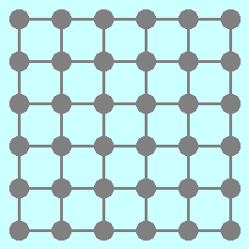
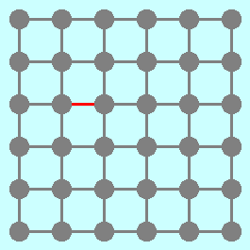
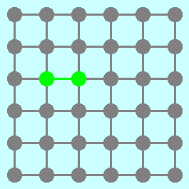
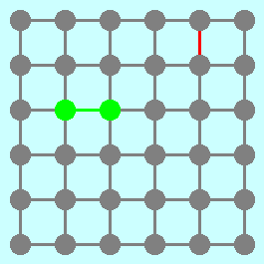
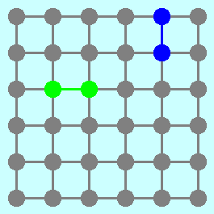
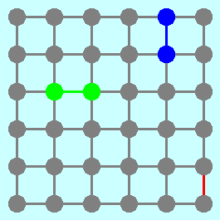
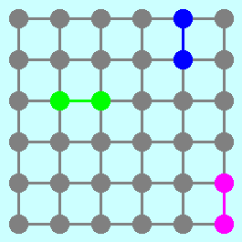
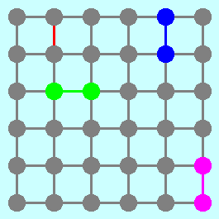
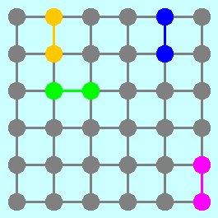
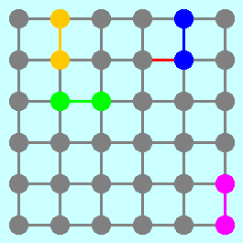
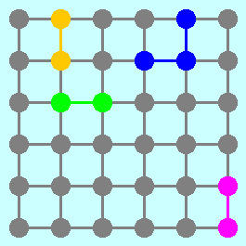
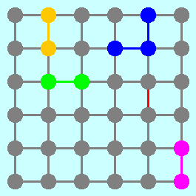
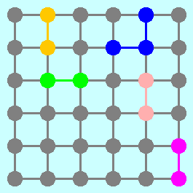
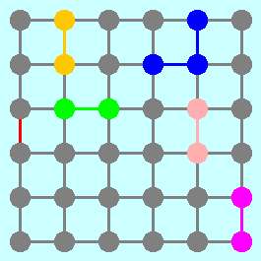
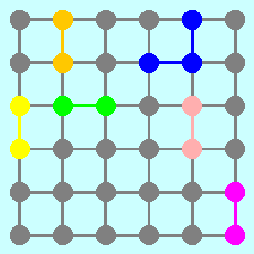
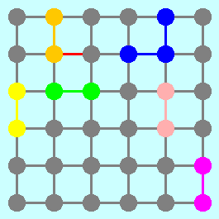
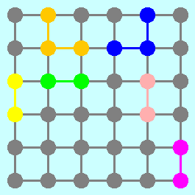
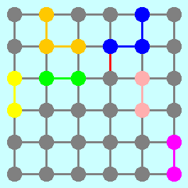
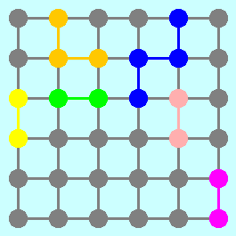
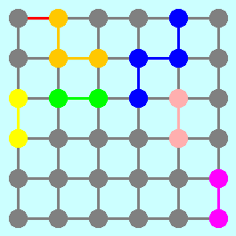
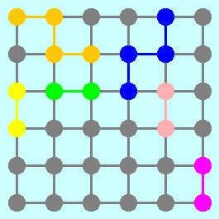

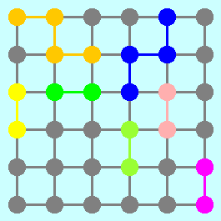
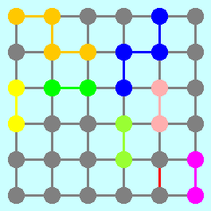
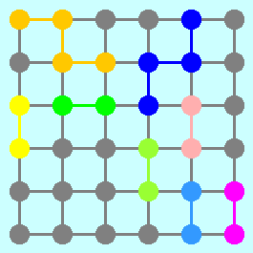
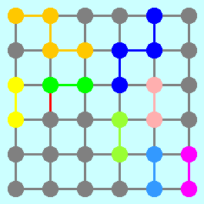
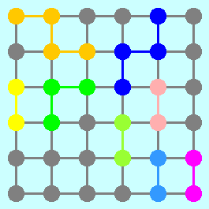
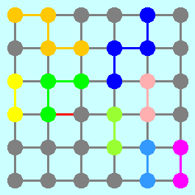
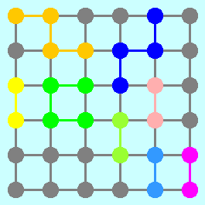
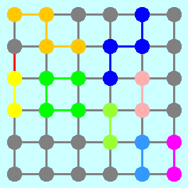
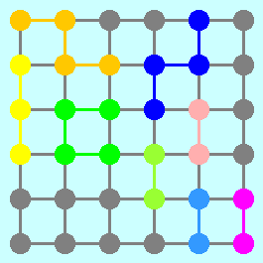
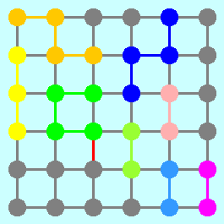
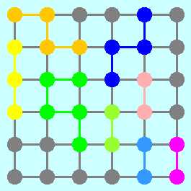
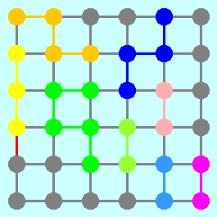
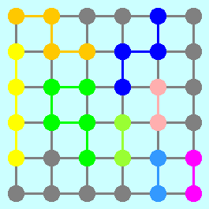

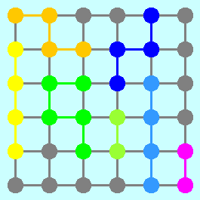

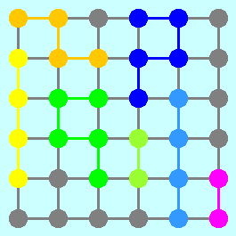
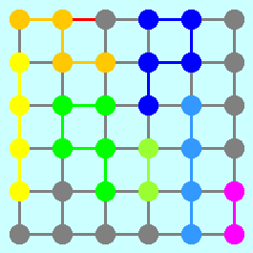
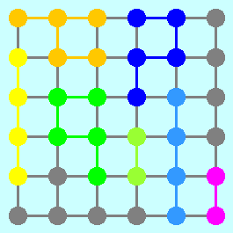
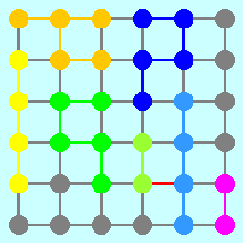
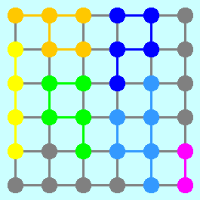
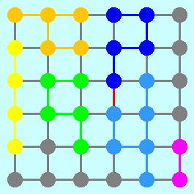
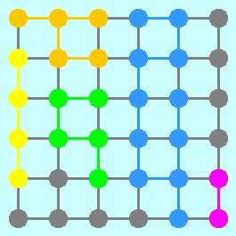
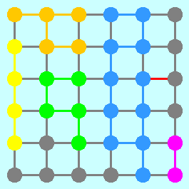
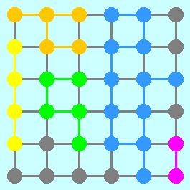
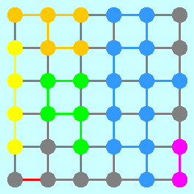
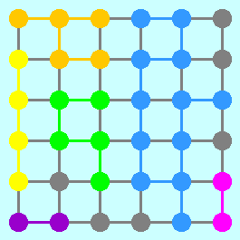








































































An Application of Kruskal’s Algorithm
Suppose that you have a graph that looks like this:
What would happen if you applied Kruskal’s algorithm for finding a minimum spanning tree, assuming that you choose the arcs in a random order?

Slide 31

Google
The big innovation of the late 1990s is the development of search engines, which began with Alta Vista at DEC’s Western Research Lab and reaching its modern pinnacle with Google, which was founded by Stanford graduate students Larry Page and Sergey Brin in 1998.
Larry Page and Sergey Brin

Slide 32
Page Rank
The heart of the Google search engine is the page rank algorithm, which was described in a 1999 by Larry Page, Sergey Brin, Rajeev Motwani, and Terry Winograd.
The PageRank Citation Ranking:
Bringing Order to the Web
January 29, 1998
Abstract
The importance of a Webpage is an inherently subjective matter, which depends on the reader’s interests, knowledge and attitudes. But there is still much that can be said objectively about the relative importance of Web pages. This paper describes PageRank, a method for rating Web pages objectively and mechanically, effectively measuring the human interest and attention devoted to them.
We compare PageRank to an idealized random Websurfer. We show how to efficiently compute PageRank for large numbers of pages. And,we show how to apply PageRank to search and to user navigation.

Slide 33
Page Rank Algorithm
The page rank algorithm gives each page a rating of its importance, which is a recursively defined measure whereby a page becomes important if other important pages link to it.
One way to think about page rank is to imagine a random surfer on the web, following links from page to page. The page rank of any page is roughly the probability that the random surfer will land on a particular page. Since more links go to the important pages, the surfer is more likely to end up there.

Slide 34



Markov Processes
Google’s random surfer is an example of a Markov process, in which a system moves from state to state, based on probability information that shows the likelihood of moving from each state to every other possible state.
A simple example of a Markov process is illustrated by this table, which shows the likelihood of a particular weather pattern for tomorrow given the weather for today.
What, then, is the likely weather two days from now, given that you know what the weather looks like today?
What if you then repeat the process for ten days?
That far out, it doesn’t matter what today’s weather is.
The day after tomorrow will be
Ten days from now will be
Tomorrow will be
If today is
0.85
0.81
0.77
0.10
0.13
0.14
0.05
0.06
0.07
0.60
0.72
0.77
0.25
0.18
0.14
0.15
0.10
0.07
0.40
0.66
0.77
0.40
0.22
0.14
0.20
0.12
0.07

Slide 35

Google’s Page Rank Algorithm

Slide 36

The Page Rank Algorithm
1.
Start with a set of pages.
A
B
D
C
E

Slide 37
The Page Rank Algorithm
2.
Crawl the web to determine the link structure.
A
B
D
C
E

Slide 38
The Page Rank Algorithm
3.
Assign each page an initial rank of 1 / N.
A
B
0.2
0.2
D
0.2
C
E
0.2
0.2

Slide 39
The Page Rank Algorithm
4.
Successively update the rank of each page by adding up the weight of every page that links to it divided by the number of links emanating from the referring page.
In the current example, page E has two incoming links, one from page C and one from page D.
Page C contributes 1/3 of its current page rank to page E because E is one of three links from page C. Similarly, page D offers 1/2 of its rank to E.
The new page rank for E is
D
0.2
C
E
0.2
0.2
PR(C)
PR(D)
0.2
0.2
PR(E) =
+
=
+
≈
0.17
3
2
3
2

Slide 40
The Page Rank Algorithm
5.
If a page (such as E in the current example) has no outward links, redistribute its rank equally among the other pages in the graph.
In this graph, 1/4 of E’s page rank is distributed to pages A, B, C, and D.
The idea behind this model is that users will keep searching if they reach a dead end.
D
0.2
C
E
0.2
0.2

Slide 41
The Page Rank Algorithm
7.
Apply this redistribution to every page in the graph.
A
B
0.28
0.15
D
0.18
C
E
0.22
0.17

Slide 42
The Page Rank Algorithm
8.
Repeat this process until the page ranks stabilize.
A
B
0.26
0.17
D
0.17
C
E
0.23
0.16

Slide 43
The Page Rank Algorithm
9.
In practice, the Page Rank algorithm adds a damping factor at each stage to model the fact that users stop searching.
A
B
0.25
0.17
D
0.18
C
E
0.22
0.17

Slide 44
The End

